Slide 1
Number System
Lec_03

Slide 2
NUMBER SYSTEM
When we type some letters or words, the computer translates them in numbers as computers can understand only numbers. A computer can understand the positional number system where there are only a few symbols called digits and these symbols represent different values depending on the position they occupy in the number.
The value of each digit in a number can be determined using:
The digit
The position of the digit in the number
The base of the number system (where the base is defined as the total number of digits available in the number system)

Slide 3
DECIMAL NUMBER SYSTEM
The number system that we use in our day-to-day life is the decimal number system. Decimal number system has base 10 as it uses 10 digits from 0 to 9. In decimal number system, the successive positions to the left of the decimal point represent units, tens, hundreds, thousands, and so on.
Each position represents a specific power of the base (10). For example, the decimal number 1234 consists of the digit 4 in the units position, 3 in the tens position, 2 in the hundreds position, and 1 in the thousands position. Its value can be written as
(1 x 1000)+ (2 x 100)+ (3 x 10)+ (4 x l) (1 x 10³)+ (2 x 10²)+ (3 x 10¹)+ (4 x l0⁰)
1000 + 200 + 30 + 4
1234

Slide 4
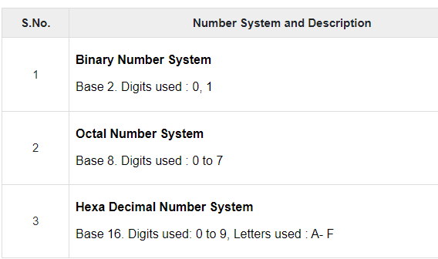
Cont.
As a computer programmer or an IT professional, you should understand the following number systems which are frequently used in computers.

Slide 5
BINARY NUMBER SYSTEM
Characteristics of the binary number system are as follows −
Uses two digits, 0 and 1
Also called as base 2 number system
Each position in a binary number represents a 0 power of the base (2). Example 2⁰
Last position in a binary number represents a x power of the base (2). Example 2^{x} where x represents the last position - 1.

Slide 6
OCTAL NUMBER SYSTEM
Characteristics of the octal number system are as follows −
Uses eight digits, 0,1,2,3,4,5,6,7
Also called as base 8 number system
Each position in an octal number represents a 0 power of the base (8). Example 8⁰
Last position in an octal number represents a x power of the base (8). Example 8^{x} where x represents the last position - 1

Slide 7
HEXADECIMAL NUMBER SYSTEM
Characteristics of hexadecimal number system are as follows
Uses 10 digits and 6 letters, 0, 1, 2, 3, 4, 5, 6, 7, 8, 9, A, B, C, D, E, F
Letters represent the numbers starting from 10. A = 10. B = 11, C = 12, D = 13, E = 14, F = 15
Also called as base 16 number system
Each position in a hexadecimal number represents a 0 power of the base (16). Example, 16⁰
Last position in a hexadecimal number represents a x power of the base (16). Example 16^{x} where x represents the last position - 1

